Slide 1
Yet Another VU-meter
A self-training project

Slide 2


Step 1 – Accessing sound info & microphone
Simple configuration file
Simple command line
Select sound card (Mixer.Info)
Access line level (DataLine.Level)
Display level as text
Console
PC
config
app
JVM
Not implemented
/ library bug?
Win64
https://www.youtube.com/watch?v=T52l6ss3SFs
https://docs.oracle.com/javase%2Ftutorial%2F/sound/accessing.html
https://docs.oracle.com/javase/tutorial/sound/sampled-overview.html

Slide 3
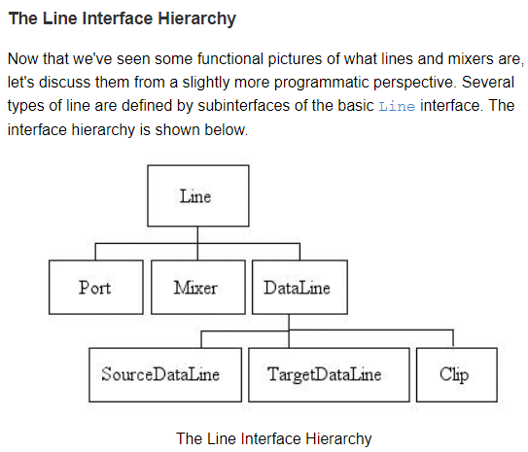
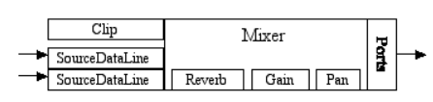
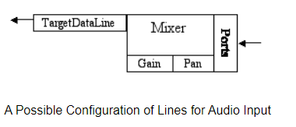

Slide 4
Limitations
DataLine.Level not implemented -> monitor buffer
Output ports cannot be monitored -> duplicate to input (virtual microphone)
eclipse 2023-12 will not say if the default JDK is too old (make sure the system’s JDK is 17+)

Slide 5
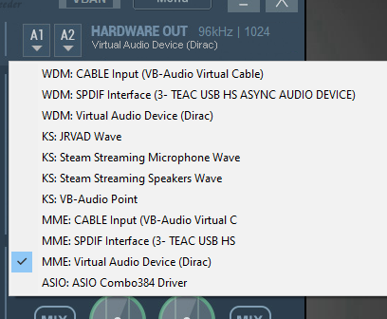
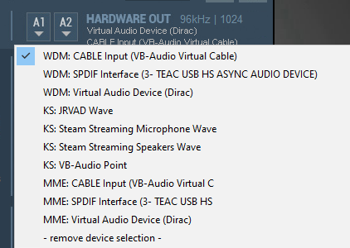
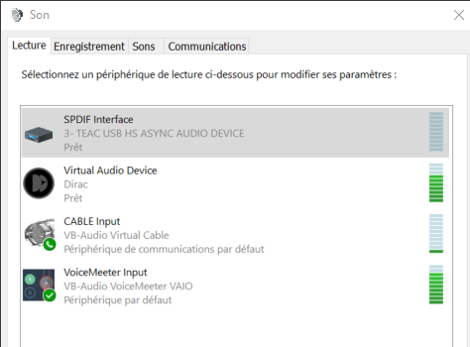

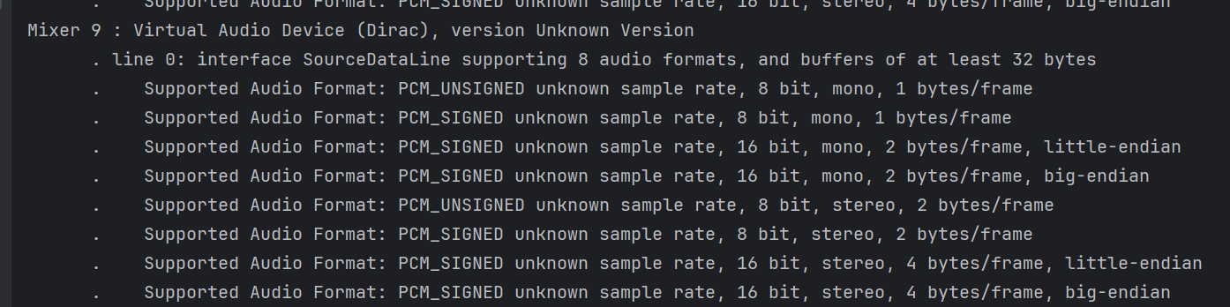
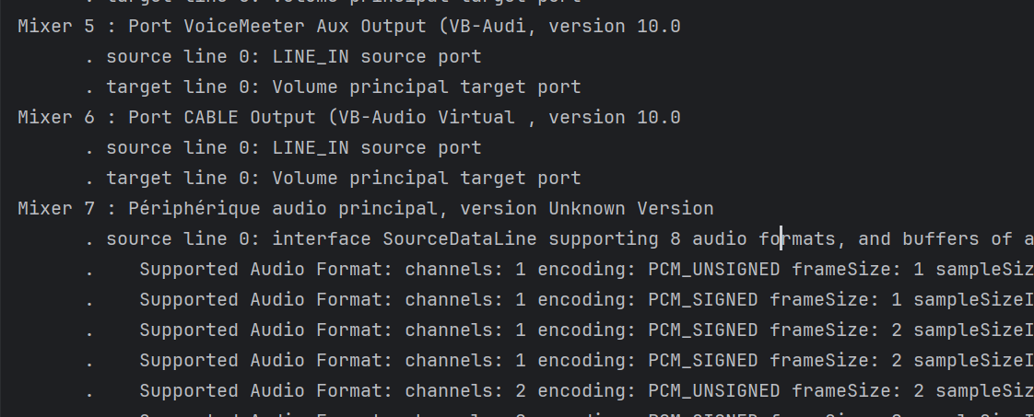
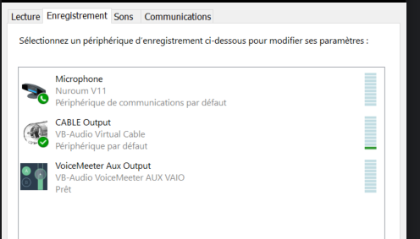
Step 2 – Accessing audio output
Create virtual output device that redirects sound to virual microphone
Duplicate and redirect
Virtual
output
device
forward
Actual audible output
VUMeter input virtual microphone
https://vb-audio.com/Voicemeeter/index.htm

Slide 6
Limitations
IDE: free IntelliJ licences might not be granted -> migrate to Eclipse → https://www.youtube.com/watch?v=iFa5dMUpWCE
Create project from Eclipse
Register into git/github:
cd <<project repository>>
git init
git add . git commit -m" first commit“ git branch -M main
git remote add origin https://github.com/devidin/yavumeter.git
git push -u origin main
https://www.youtube.com/watch?v=gO20QGT6aW8

Slide 7
Secured authentication
Cf. https://www.youtube.com/watch?v=XFgol-F9cnc

Slide 8
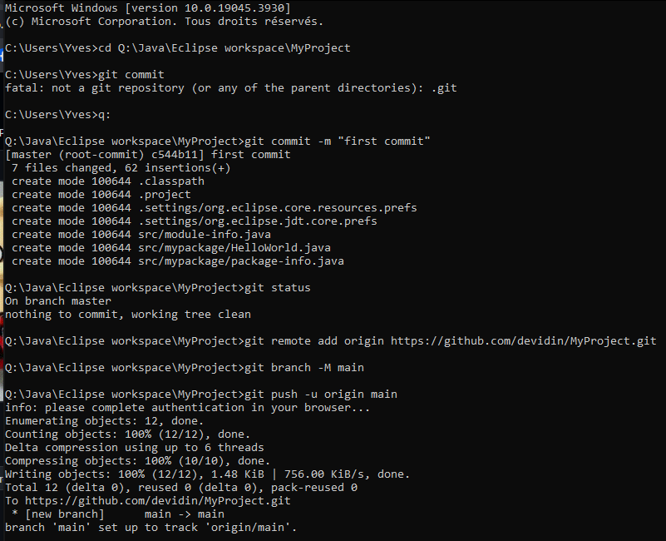
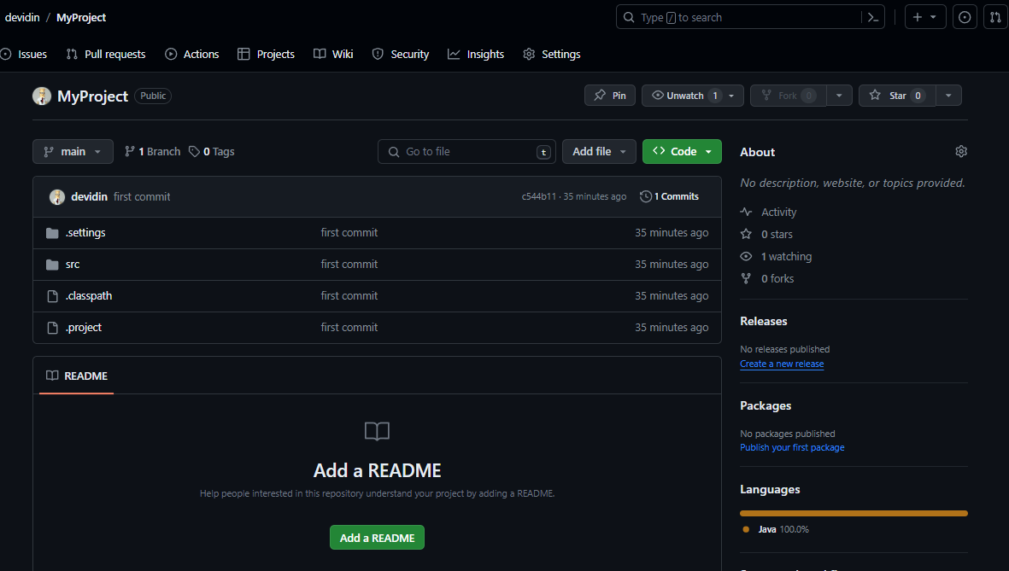
GitHub : start from scratch

Slide 9
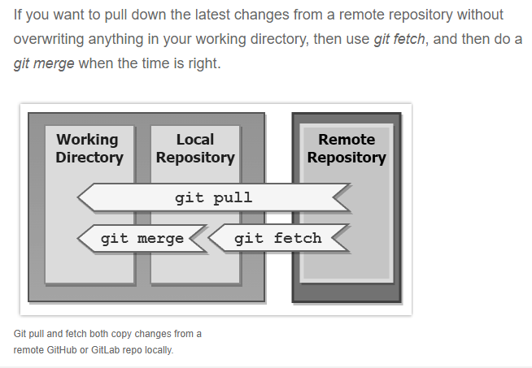
Aligning code with github

Slide 10
Limitations
Requires logging → integrate with log4J or equivalent
Requires configuration
On going…

Slide 11
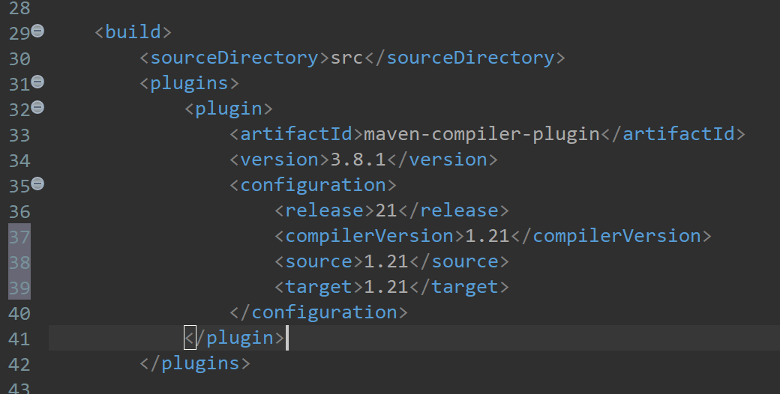
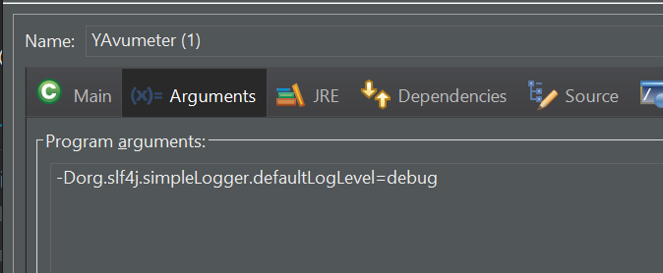
Logging
Alternatives: Log4j, Log4j 2, Logback+ SL4J (https://www.baeldung.com/java-logging-intro)
Selection: SL4J+Logback because provides a common interface and abstraction for most of the Java logging frameworks. https://www.baeldung.com/logback
Requires to convert to Maven project
Specify compilation option in pom.xml:
Configure SL4J/logback: https://logback.qos.ch/setup.html

Slide 12
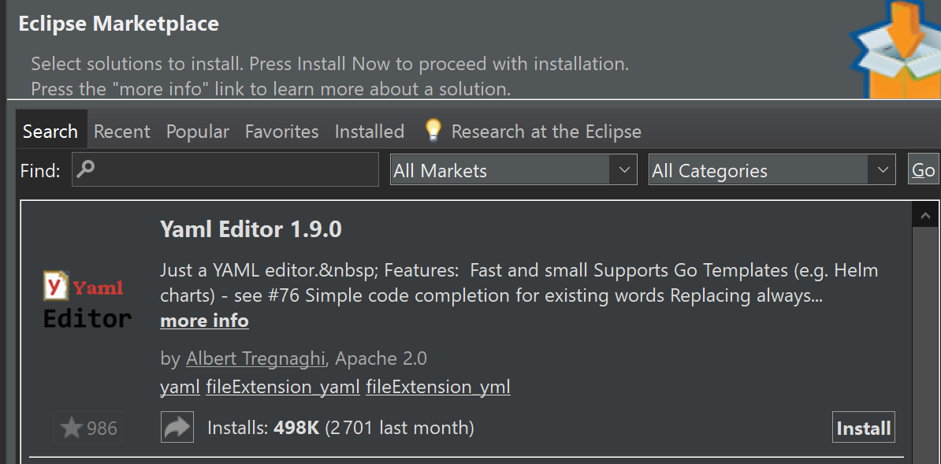
Configuration
Selected solution: snakeyaml
Eclipse plugin :
https://marketplace.eclipse.org/content/liclipsetext
Note: https://github.com/de-jcup/update-site-eclipse-yaml-editor/tree/main is not working... (failed to connect from eclipse)

Slide 13
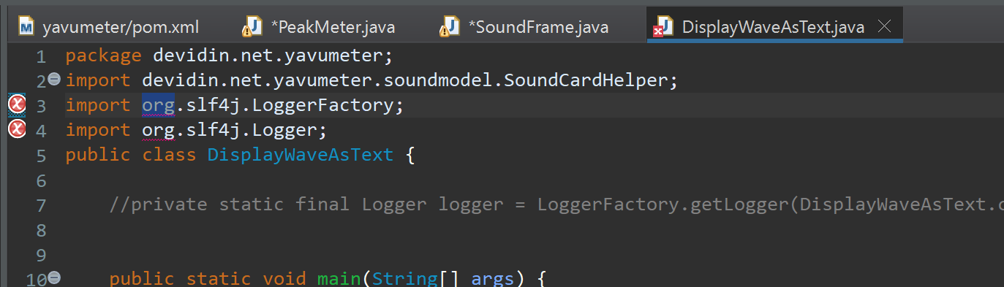
Libraries not accessible

Slide 14
Step 3 – Graphical representation
Console output too slow → requires graphical representation (cf.
Console output too slow → requires graphical representation (cf.
GUI Framework: JavaFX
TODO

Slide 15
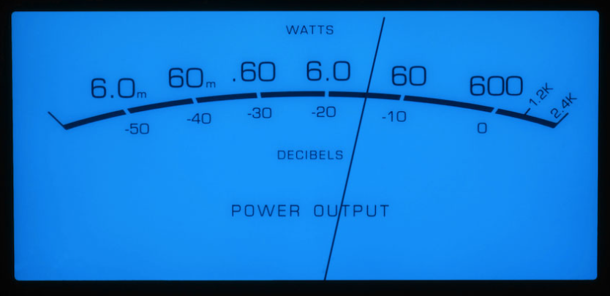
Graphical representation - layout
height
needleLength
minAngle
width
maxAngle

Slide 16
Graphical representation - coordinates
(0,0)
needleLength
Min (xMin, yMin)
Max (xMax, yMax)
minAngle
height
width
maxAngle
C (xC, yC)

Slide 17
Graphical representation - coordinates
Min (xMin, yMin)
minAngle
xMin – xC
cosMin =
needleLength
needleLength
C (xC, yC)

Slide 18
Graphical representation - calculations
Input
Background → width, height
Configuration
xC (default = width/2)
yC (default = -height / 5)
xMin (default = witdh/10)
yMin (default = height/3)
xMax (default = 9*width/10)
yMax : not configurable
needleRed = 0..255 (default = 0)
needleGreen = 0..255 (default = 0)
needleBlue = 0..255 (default = 0)
Calculations
needleLength = sqrt( (xMin-xC)² + (yMin-yC)² )
minAngle = arccos((xMin – xC) / needleLength)
maxAngle = arccos((xMax – xC) / needleLength)
yMax = yC + needleLength * sin (maxAngle)
height
width
C (xC, yC)
Min (xMin, yMin)
Max (xMax, yMax)
needleLength
minAngle
maxAngle

Slide 19
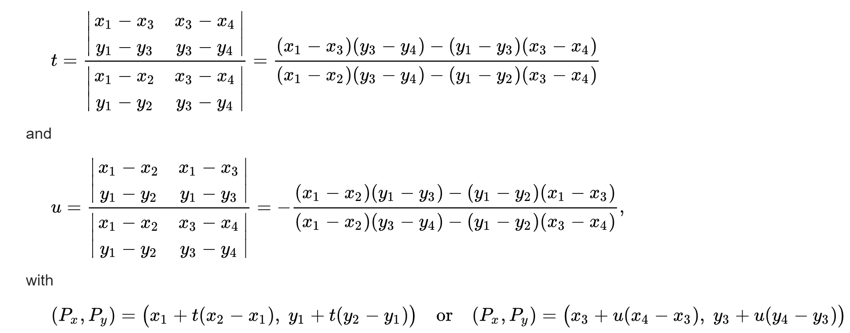
Intersection of 2 segments
(x4,y4)
https://en.wikipedia.org/wiki/Line%E2%80%93line_intersection
(x2,y2)
(x1,y1)
(xI,yI)
denominator
(x3,y3)
// Calculate the intersection point of two line segments
public static double[] calculateIntersection(double x1, double y1, double x2, double y2,
double x3, double y3, double x4, double y4) {
double[] intersection = new double[2];
double denominator = (x1 - x2) * (y3 - y4) - (y1 - y2) * (x3 - x4);
// Check if the lines are parallel (denominator is zero)
if (denominator == 0) {
return null; // No intersection
}
double t = ((x1 - x3) * (y3 - y4) - (y1 - y3) * (x3 - x4)) / denominator;
double u = -((x1 - x2) * (y1 - y3) - (y1 - y2) * (x1 - x3)) / denominator;
// Check if the intersection point is within the line segments
if (t >= 0 && t <= 1 && u >= 0 && u <= 1) {
intersection[0] = x1 + t * (x2 - x1);
intersection[1] = y1 + t * (y2 - y1);
return intersection;
} else {
return null; // Intersection is outside the line segments
}
}

Slide 20
Graphical representation – drawing needle
(0,0) – (0,0)
(width, 0)
(dX, dY)
maxAmplitude = 2^{bitPerFrame-1}
μ = (maxAngle-minAngle)
α = minAngle + amplitude * μ / maxAmplitude
X = xC + cos(α) * needleLength
Y = yC + sin(α) * needleLength
(xI, YI) = calculateIntersection(0,height, width,height, xC,yC, X,Y)
… if null → (xC, yC)
(dX, dY) = ( X * dWidth/width, Y * dHeight/height )
(dXi, dYi) = ( xI * dWidth/width, yI * dHeight/height )
Draw area
(dXi, dYi)
(dWidth, dHeight)
μ
(X, Y)
0
α
max
image
(xI, yI)
(0, height)
(width, height)
(xC, yC)

Slide 21
Background design

Slide 22
Background
-7
-5
-3
-1
0
-10
⁺1
⁺2
-20
⁺3
P O W E R L E V E L
D E C I B E L S

Slide 23
Background
-7
-5
-3
-1
0
-10
⁺1
⁺2
-20
⁺3
P O W E R L E V E L
D E C I B E L S

Slide 24
Background
-7
-5
-3
-1
0
-10
⁺1
⁺2
-20
⁺3
P O W E R L E V E L
D E C I B E L S

Slide 25
Background - blue
-7
-5
-3
-1
0
-10
⁺1
⁺2
-20
⁺3
P O W E R L E V E L
D E C I B E L S

Slide 26
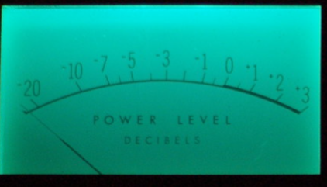
Background - green
-7
-5
-3
-1
0
-10
⁺1
⁺2
-20
⁺3
P O W E R L E V E L
P O W E R L E V E L
D E C I B E L S
D E C I B E L S

Slide 27
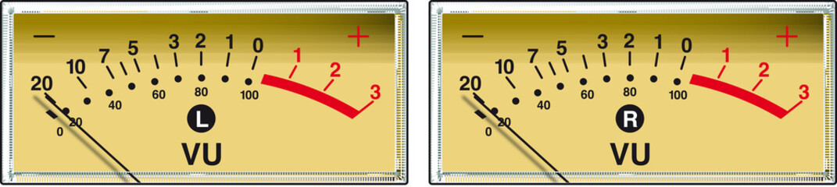
Background - yellow
-7
-5
-3
-1
0
-10
⁺1
⁺2
-20
⁺3
P O W E R L E V E L
P O W E R L E V E L
D E C I B E L S
D E C I B E L S

Slide 28
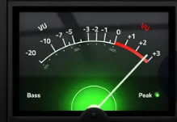
Background - black
-7
-5
-3
-1
0
-10
⁺1
⁺2
-20
⁺3
P O W E R L E V E L
P O W E R L E V E L
D E C I B E L S
D E C I B E L S

Slide 29
Background - white
-7
-5
-3
-1
0
-10
⁺1
⁺2
-20
⁺3
P O W E R L E V E L
P O W E R L E V E L
D E C I B E L S
D E C I B E L S

Slide 30
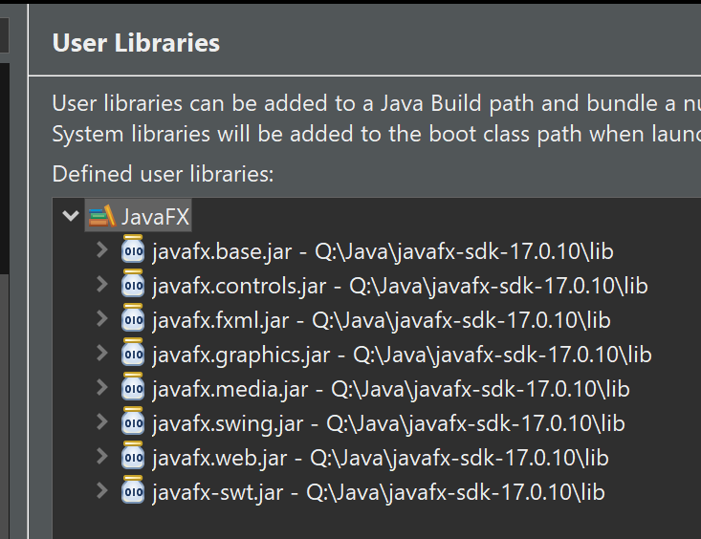
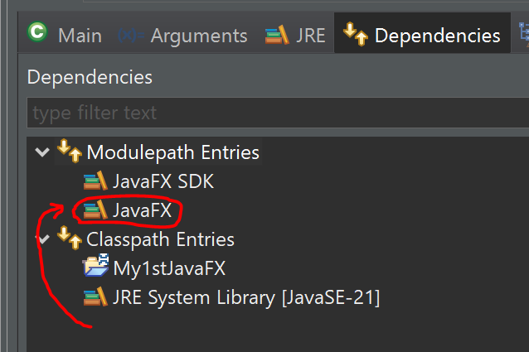
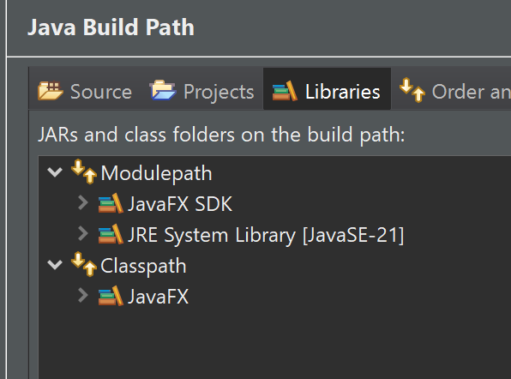
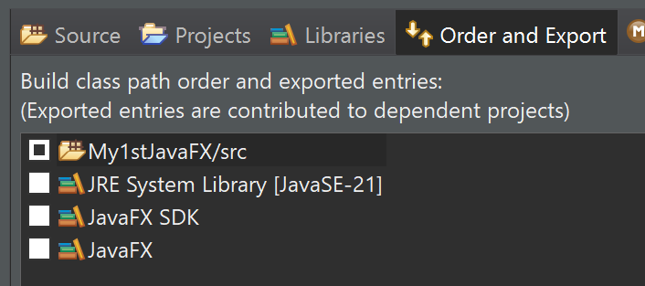

JavaFX
Integration with Eclipse: cf. https://www.youtube.com/watch?v=bk28ytggz7E
https://www.youtube.com/watch?v=nz8P528uGjk
Download SKD: https://openjfx.io/
:
! Delete module-info from generated project

Slide 31
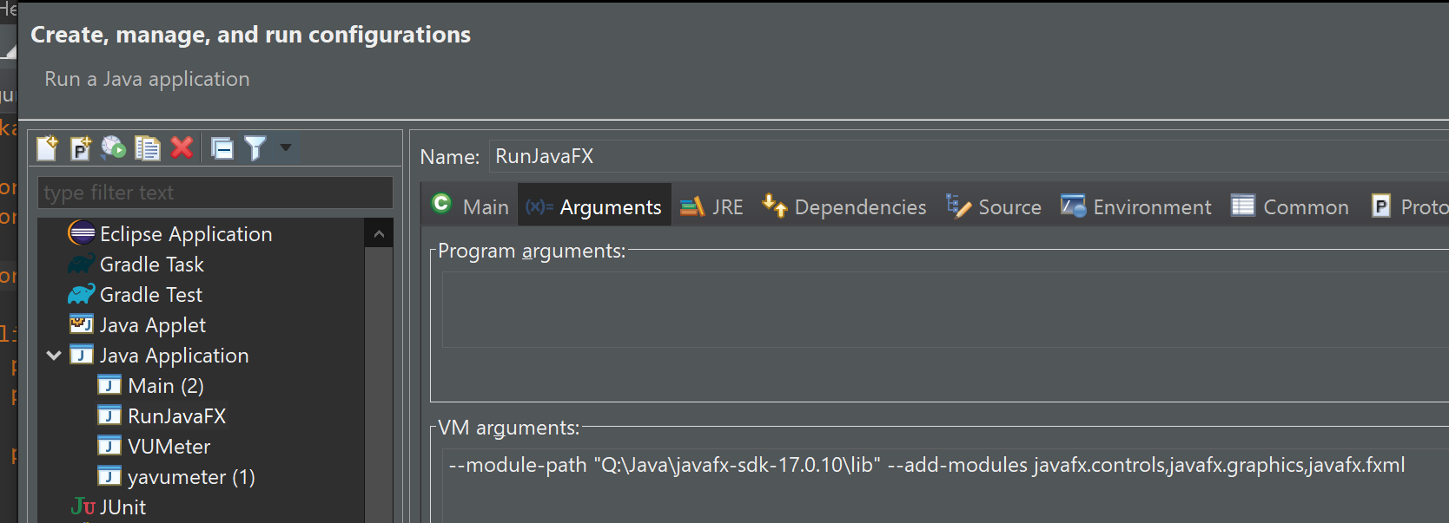
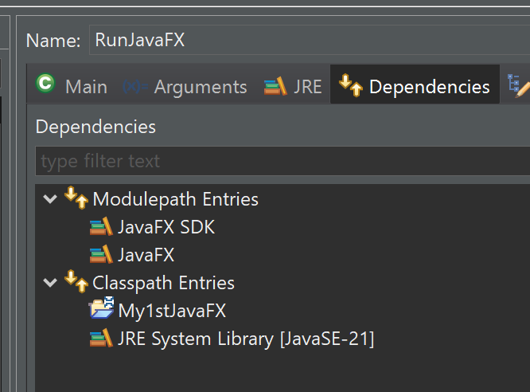
Run configuration

Slide 32

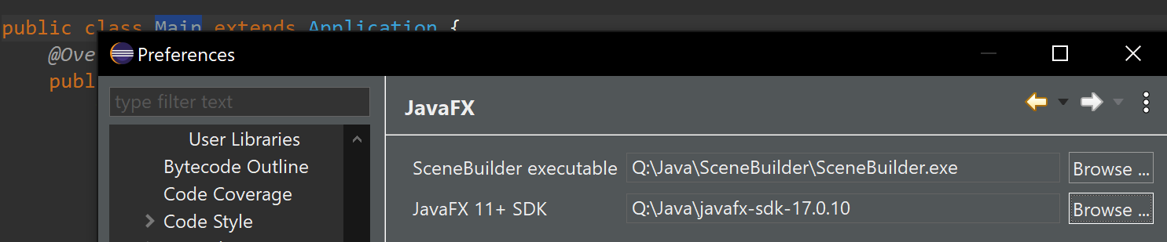
Screen design – Scene Builder
Install:
https://www.youtube.com/watch?v=cfGTJVVcWvE&list=PLpFneQZCNR2ktqseX11XRBc5Kyzdg2fbo
Use:
https://www.youtube.com/watch?v=HBBtlwGpBek
https://www.youtube.com/watch?v=q5A-qW2eGKs&list=PLpFneQZCNR2ktqseX11XRBc5Kyzdg2fbo&index=2

Slide 33
UML
sirius

Slide 34
Release
Build, Release, Publish, install on another machine from github

Slide 35
OSGi
To evaluate..

Slide 36
Step 4 – C/S model (angular+Spring)
GUI Framework: Angular
Server : swing
TODO

Slide 37
Step 5 – Mobile
Reverse client/server model (like X-windows)?
Framework: ??
TODO

Slide 38
Bypass VoiceMeter
Integrate custom Java interface with some C++ library or custom dev to directly access a selected output device (target mixer) instead of redirecting output with VoiceMeter to a virtual microphone

